Slide 1

Darpan Kumar
Providing IT services since last 30 years
Presence in 9 countries
3 offshore offices in India
https://www.7n.com/

Slide 2
Global Error Handling in Angular.

Slide 3
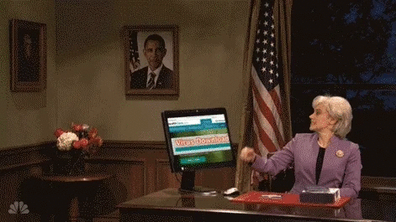

Slide 4


Slide 5
HttpInterceptor Interface
ErrorHandler Class
Server Side Errors
ErrorHandler Class
Client Side Errors
Global Error Handling in Angular

Slide 6
Error Handler Class
Create a service.
Implement your own handleError method, distinguish between the front end and backend error and take the appropriate action .
Configure this new service to handle errors.

Slide 7
HttpInterceptor Interface
Create a service.
Implement the HttpInterceptor interface.
Implement intercept method.
Configure this new service to intercept your backend calls.

Slide 8


Slide 9
Thank you

